Slide 1
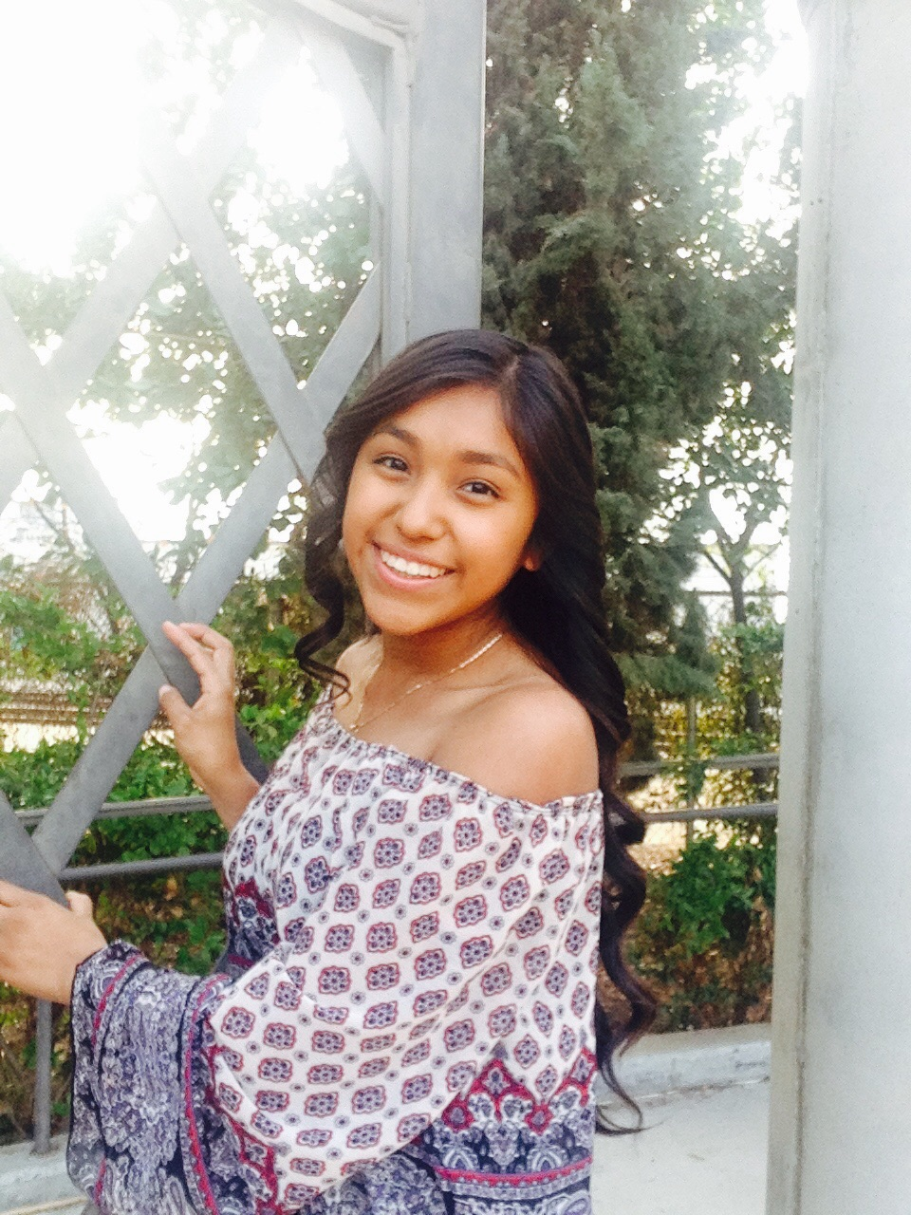
Mireyda Hernandez
Class of 2017

Slide 2
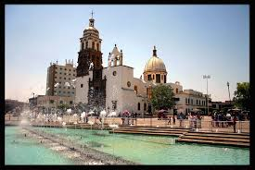
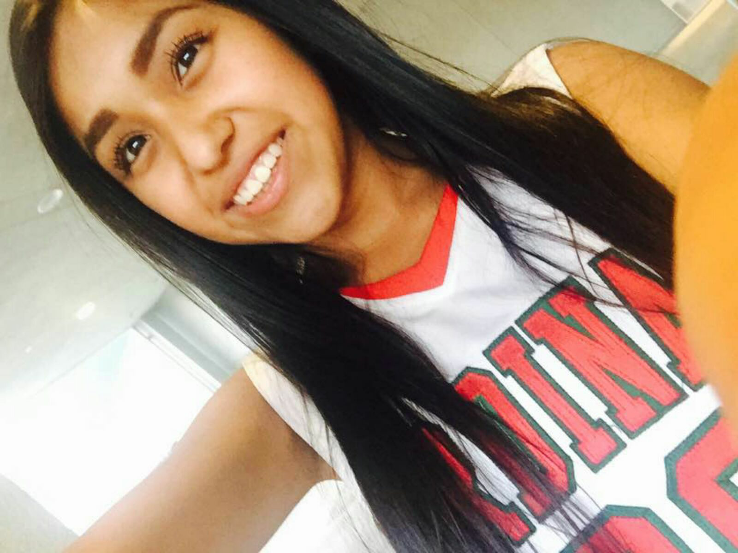
About Me
I am 17 years old
I was born in Irapuato, Guanajuato
I am the oldest of three
Characteristics: kind, respectful, and responsible
My biggest goal is to graduate from Lindsay High school
First in my family to graduate
Working for Roosevelt stars

Slide 3
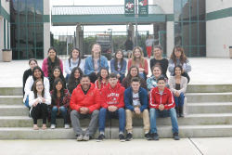
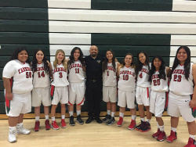
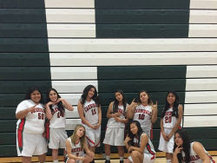
Experiences at Lindsay High school
Yearbook
Color Guard
My Voice
Basketball

Slide 4
Career Pathway
Spanish
It is very important to be bilingual
Improved in my writing
Taking Spanish 3
My first career option

Slide 5
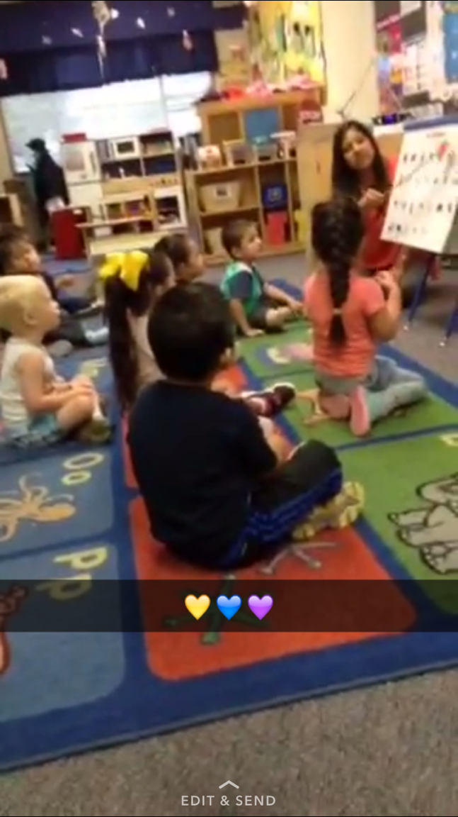
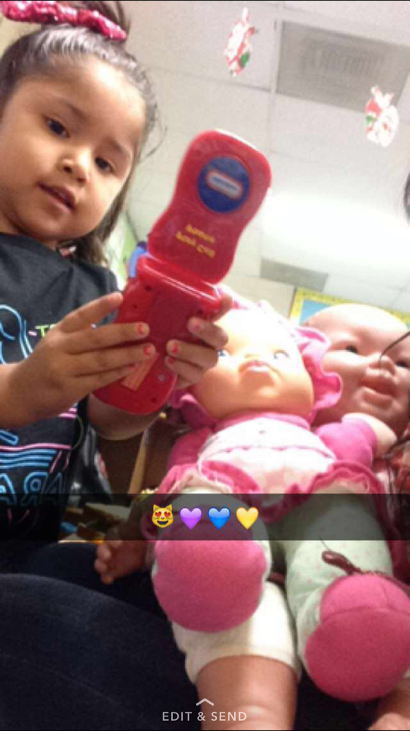
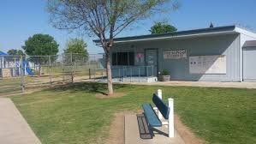
Job Shadow
Took place at Jefferson Elementary
Miss. Liz Preschool teacher
Fun and great experience
This would be something I would like to do in the future as my
second option

Slide 6
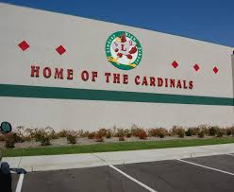
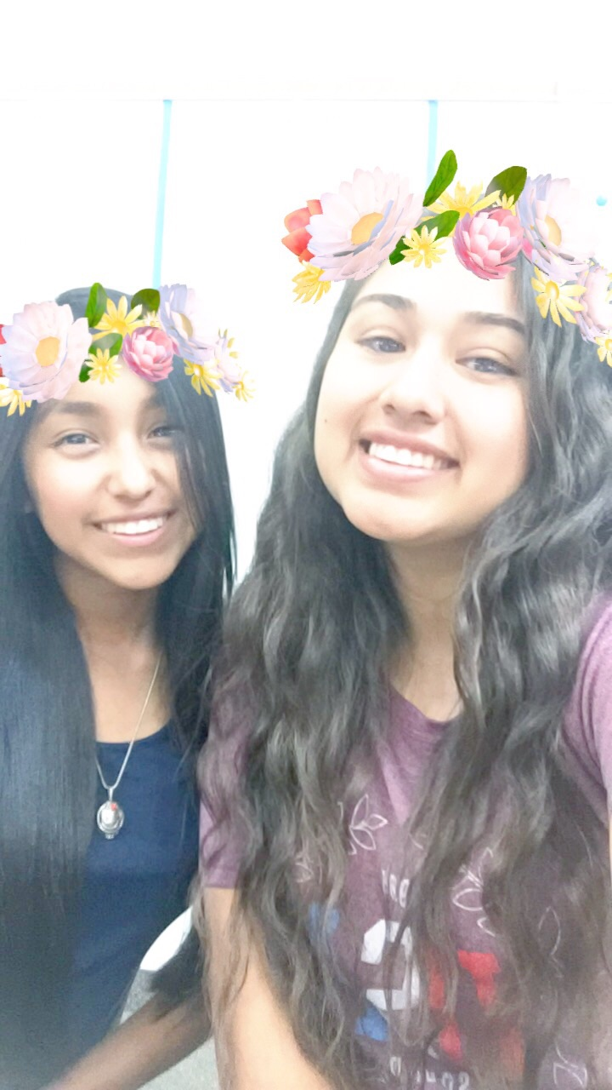
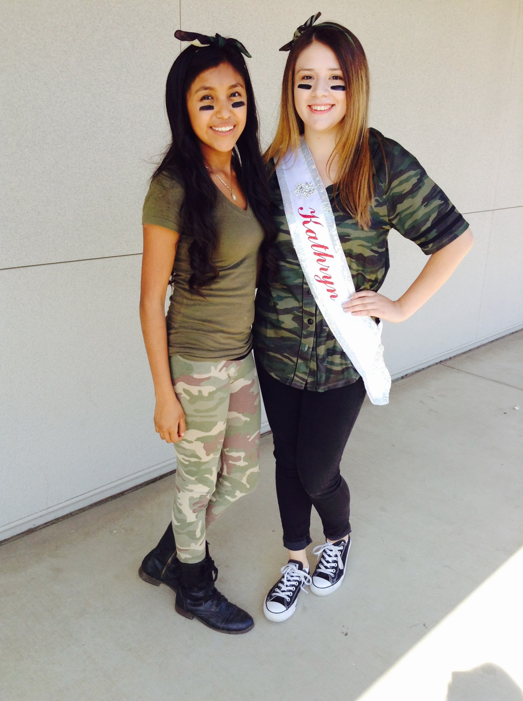
Goodbye to Lindsay High school
Became a good role model
Be prepared for my future
Work hard to accomplish my goals and never give up

Slide 7
Post High school plans
Attend to College of the Sequoias and transfer to a University
In my future get my Master's degree
Work while I am attending C.O.S

